Slide 1
CSE1142 – Pointers in C
Adapted from Dr. Sanem Arslan Yılmaz.
Some of the slides are from: CMPE150 – Boğaziçi University, Deitel & Associates.

Slide 2
Agenda
Pointer
  Variable definitions
  Initialization
Pointer Operators
How to use pointers in Functions
Passing Arguments to Functions by Reference
Pointer Expressions and Pointer Arithmetic
Using the const Qualifier with Pointers
Relationship Between Pointers and Arrays
Array of Pointers

Slide 3
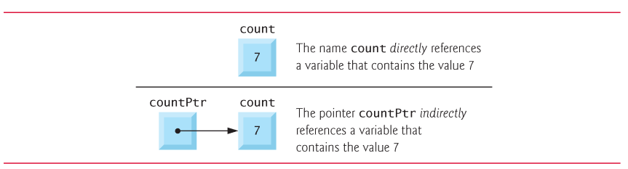
Pointer Variable Definitions and Initialization
Pointer variables
  Contain memory addresses as their values
  Normal variables contain a specific value (direct reference)
  Pointers contain address of a variable that has a specific value (indirect reference)
  Indirection – referencing a pointer value

Slide 4
Pointer Variable Definitions and Initialization – cont.
Pointer definitions
  * used with pointer variables
      int *myPtr;
  Defines a pointer to an int (pointer of type int *)
  Multiple pointers require using a * before each variable definition
      int *myPtr1, *myPtr2;
  Can define pointers to any data type
  Initialize pointers to 0, NULL, or an address
    0 or NULL – points to nothing (NULL preferred)
    A pointer with the value NULL points to nothing.

Slide 5
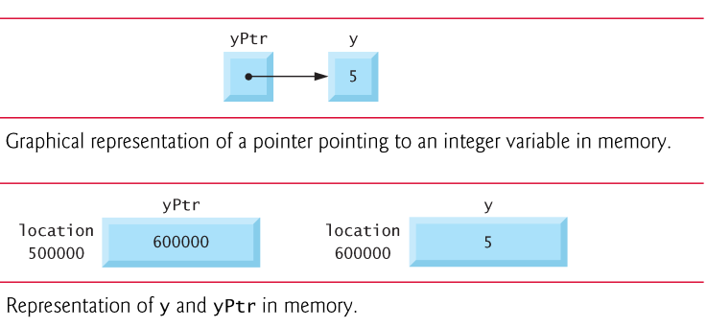
Pointer Operators
& (address operator)
  Returns address of operand
    int y = 5;
    int *yPtr;
    yPtr = &y;
  yPtr gets address of y
    yPtr “points to” y

Slide 6
Pointer Operators – cont.
* (indirection/dereferencing operator)
  Returns a synonym/alias of what its operand points to
  *yptr returns y (because yptr points to y)
  * can be used for assignment
    Returns alias to an object
      *yptr = 7; /* changes y to 7 */
  Dereferenced pointer (operand of *) must be an lvalue (no constants)
* and & are inverses
  They cancel each other out

Slide 7
How to use pointers in Functions
Define the parameter as pointer
*
*
Use '*' before the parameter name so that you access the value at the mentioned address
&
Send the address of the argument
  void func(int num)
  { num = 5;
  }
  int main()
  { int count=10;
  func( count);
  }

Slide 8
Example
#include <stdio.h>
void f(int *a)
{
*a+=5;
printf("in function f(): a=%d\n", *a);
}
int main()
{ int a=10;
printf("in main(), before calling f(): a=%d\n",a);
f(&a);
printf("in main(), after calling f(): a=%d\n",a);
}
f()
a
OUTPUT
main()
a
15
10
in main(), before calling f(): a=10
in function f(): a=15
Stack
in main(), after calling f(): a=15

Slide 9
Passing Arguments to Functions by Reference
There are two ways to pass arguments to a function
  pass-by-value and pass-by-reference.
All arguments in C are passed by value.
  a copy of the argument in the function call is made and passed to the function.
Use pointers and the indirection operator to simulate pass-by-reference.
Arrays are not passed using operator &
  C automatically passes the starting location in memory of the array
  The name of an array is equivalent to &arrayName[0]
  When the compiler encounters a function parameter for a one-dimensional array of the form int b[], the compiler converts the parameter to the pointer notation int *b.

Slide 10
Pointer Expressions and Pointer Arithmetic
Arithmetic operations can be performed on pointers
  Increment/decrement pointer (++ or --)
  Add an integer to a pointer( + or += , - or -=)
  Pointers may be subtracted from each other
  Operations meaningless unless performed on an array or string

Slide 11
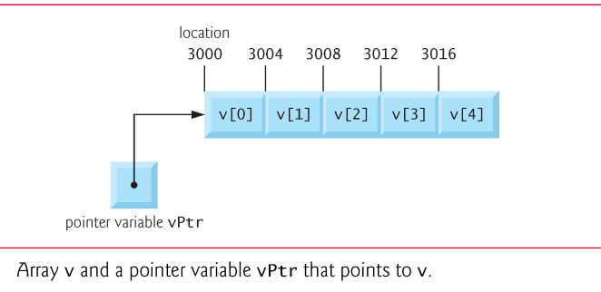
Pointer Expressions and Pointer Arithmetic – cont.
Assume that array int v[5] has been defined on a machine with 4 byte ints
  vPtr points to first element v[0]
    at location 3000 (vPtr = 3000)
  vPtr += 2; sets vPtr to 3008
    vPtr points to v[2] (incremented by 2),
    but the machine has 4 byte ints,
    so it points to address 3008

Slide 12
Pointer Expressions and Pointer Arithmetic – cont.
In conventional arithmetic, 3000 + 2 yields the value 3002.
This is normally not the case with pointer arithmetic.
When an integer is added to or subtracted from a pointer, the pointer is not incremented or decremented simply by that integer, but by that integer times the size of the object to which the pointer refers.
For example, the statement
    vPtr += 2;
would produce 3008 (3000 + 2 * 4),
assuming an integer is stored in 4 bytes of memory.

Slide 13
Pointer Expressions and Pointer Arithmetic – cont.
Subtracting pointers
  If vPtr had been incremented to 3016, which points to v[4], the statement
    vPtr -= 4;
would set vPtr back to 3000—the beginning of the array.
  Increment/decrement operators
    Either of the statements
      ++vPtr;
      vPtr++;
increments the pointer to point to the next location in the array.
    Either of the statements
      --vPtr;
      vPtr--;
decrements the pointer to point to the previous element of the array

Slide 14
Pointer Expressions and Pointer Arithmetic – cont.
Pointer variables may be subtracted from one another.
  Returns number of elements from one to the other.
    vPtr2 = &v[2]; (vPtr2 = 3008)
    vPtr = &v[0]; (vPtr = 3000)
  x = vPtr2 - vPtr // would assign to x the value of 2 (not 8)
Pointer comparison ( <, == , > )
  See which pointer points to the higher numbered array element
  A common use of pointer comparison is determining whether a pointer is NULL.

Slide 15
Pointer Expressions and Pointer Arithmetic – cont.
A pointer can be assigned to another pointer if both have the same type.
The exceptional case:
  void * (pointer to void)
  A generic pointer that can represent any pointer type.
    A memory location for an unknown data type.
  All pointer types can be assigned a pointer to void, and a pointer to void can be assigned a pointer of any type.
  In both cases, a cast operation is not required.
  A pointer to void cannot be dereferenced.

Slide 16
Using the const Qualifier with Pointers
const qualifier
  Variable cannot be changed
  Use const
    If a variable should not change in the body of a function to which it is passed, the variable should be declared const to ensure that it is not accidentally modified.
  Attempting to change a const variable produces an error
const pointers
  Always point to the same memory location
  Must be initialized when defined

Slide 17
Const pointers
  The declaration is read from right to left.
  int *const myPtr = &x;
    Type int *const – constant pointer to an int
  const int *myPtr = &x;
    Regular pointer to a const int
  const int *const Ptr = &x;
    const pointer to a const int
    x can be changed, but not *Ptr

Slide 18
Example – Constant Data
// f attempts illegal modification
// Not allowed since xPtr is a pointer to a constant integer
int main(void){
int y; // define y
f(&y);
}
// xPtr cannot be used to modify the
// value of the variable to which it points
void f(const int *xPtr){
*xPtr = 100;
}
Notes:
- Run C41_05_constant_data.c.

Slide 19
Example – Constant Address
// allowed: *ptr is not const
// error: ptr is const; cannot assign new address
int main(void){
int x; // define x
int y; // define y
// ptr is a constant pointer to an integer that can be modified through ptr,
// but ptr always points to the same memory location
int *const ptr = &x;
*ptr = 7;
ptr = &y;
}
Notes:
- Run C41_10_constant_address.c.

Slide 20
Example – Constant Address and Data
// error: *ptr is const; cannot assign new value
// error: ptr is const; cannot assign new address
int main(void){
int x = 5; // initialize x
int y; // define y
// ptr is a constant pointer to a constant integer.
// ptr always points to the same location; the integer at that location cannot be modified
const int *const ptr = &x; // initialization is OK
printf("%d\n", *ptr);
x++;
*ptr = 7;
ptr = &y;
}
Notes:
- Run C41_15_constant_address_data.c.

Slide 21
sizeof Operator
Determine the size in bytes of any data type.
sizeof operator returns the total number of bytes as type size_t.
  printf(“Size of an integer %u”, sizeof(int));
Consider the following array definition:
  double real[22];
  Determine the number of elements in the array
    sizeof(real) / sizeof(real[0])

Slide 22
Relationship Between Pointers and Arrays
Arrays and pointers are intimately related in C and often may be used interchangeably.
An array name can be thought of as a constant pointer.
Assume that integer array b[5] and integer pointer variable bPtr have been defined.
  bPtr = b;
Array element b[ 3 ]
  Can be accessed by *( bPtr + 3 )
    Where 3 (or simply n) is the offset. Called pointer/offset notation
  Can be accessed by bptr[ 3 ]
    Called pointer/subscript notation
  Can be accessed by performing pointer arithmetic on the array itself
    bPtr[ 3 ] same as b[ 3 ]
    *( b + 3 )

Slide 23
Examples
array_example.c
string_example.c
pointers_vs_arrays.c

Slide 24
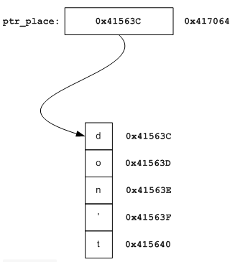
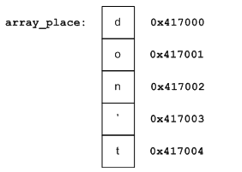
Pointers vs. Arrays
char array_place[12] = "don't panic";
char* ptr_place = "don't panic";
char a = array_place[7];
char b = ptr_place[7];

Slide 25
Pointer and Array Traversal
for (i = 0; i < sizeof(array_place); ++i)
printf("%c ", array_place[i]);
for (; *ptr_place; ++ptr_place)
printf("%c ", *ptr_place);

Slide 26
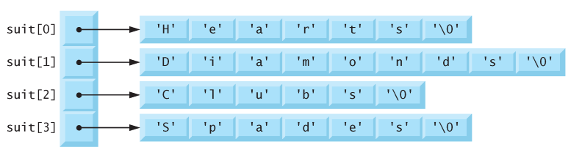
Array of Pointers
Arrays may contain pointers.
A common use of an array of pointers is to form an array of strings, referred to simply as a string array.
Each entry in an array of strings is actually a pointer to the first character of a string.
const char *suit[4] = {"Hearts", "Diamonds", "Clubs", "Spades"};

